Slide 1
HND Networking:
Multi User Operating Systems
(DH3A 34)
Week 2
Lecturer – Dawn Wilson

Slide 2
Operating System Overview - Review
What is an Operating System?
  A collection of computer programs, which combine to manage the components of a computer system in a controlled manner.
  File management, process management, memory management, peripherals
Why is an Operating System Required?
  an interface between the user and the hardware to make the computer easier to use
  a cost effective/efficient use of the hardware resources

Slide 3
Operating System Types- Review
Batch – similar jobs grouped together into a batch and subsequently processed in a sequential manner; No user interaction; Efficient use of hardware.
Interactive/Time-sharing – user has two way communication with the computer and can interact directly with the O/S; minimises response time; processor’s time is shared among multiple users simultaneously.
Real-Time – rigid time constraints place on processor and flow of data; used in “mission critical” systems.
Distributed – each node has a subset of the overall O/S; increases scale and availability. Remote resources are transparent to the user

Slide 4
OS Environments - Review
Single User
  Single user means the OS provides support for one user at a time to use its facilities, can be split into two types:
    single user, single application operating systems
      operating system only has to deal with one person at a time, running one user application at a time e.g. MS-DOS
    single user, multi tasking operating systems
      operating system is designed mainly with a single user in mind, but it can deal with many applications running at the same time e.g. Windows
Multi User
  Multi user means that the OS must provide support to more than one user simultaneously
  Must support all of the features of a single OS and allow multiple users access to multiple applications

Slide 5
Types of MUOS - Review
Multi-processor (parallel) systems
  two or more Central Processing Units (CPUs) share the same resources and service the same work
Time-sliced (time-sharing) systems
  processor will switch from one process to another on a timed basis.
Distributed operating systems
  Distributed Processing is a technique of distributing the tasks over a number of devices, taking advantage of the large pool of resources

Slide 6
MUOS Features
We have looked at the types of MUOS
  multi-processor, time-sliced, distributed
Now we are going to look at the features it must provide in order to meet the requirements of a true multi-user operating system:
  Resource sharing
  Multi-tasking
  Background processing

Slide 7
MUOS Feature Resource Sharing

Slide 8
Key Feature of MUOS - Resource Sharing
What is a resource?
  Central Processing Unit (CPU)
  Memory (RAM/ROM)
  Peripheral devices (Disk drives, Printers, Scanners etc)
  Software (Processes) or Data (Files)
OS must control, manage and share these resources amongst multiple users running multiple applications
Scheduling :
  process places a request for a resource, either it acquires the resource immediately or it will be required to wait (placed in a queue) until the resource is free. (At least this is the case if all processes are of equal priority).
  Should a new process have a higher priority than a currently running process, the new process is allocated the resource and the current process is placed in a queue of partially completed processes until such time that the process may be completed

Slide 9
Key Feature of MUOS - Resource Sharing
This process of swapping processes in and out of the CPU is generally known as a context switch or process switch
The OS must manage resources in such a way that all processes eventually get enough resources in order to complete their required tasks.
A process that does not get enough resources to complete its task dies of starvation.

Slide 10
Key Feature of MUOS - Resource Sharing
OBJECTIVES
High system throughput - rate at which useful work is done.
Low Response time - time taken by a computer to issue output in response to a user typing a command at a terminal.
High Resource Utilisation - Keep the resources as busy as you can for as much of the time as you can.
Low Overheads - Time spent controlling the scheduling of different tasks
Predictable Behaviour - The system must exhibit the same behaviour for similar tasks over a period.
The above objectives are particularly difficult to achieve even one at a time; however the system must attempt to meet some target for all five objectives.

Slide 11
Features of MUOS - Resource Sharing
CONSTRAINTS
There are a number of constraints upon any plan for scheduling processes, including:
System Capacity - This constrains overall output, for example; a more powerful processor can handle more processes in a given amount of time. The same reasoning applies to the amount of memory available.
Nature of Workload - This constrains predictability, as types of processes may vary radically; some may be CPU intensive, such as statistical analysis, in contrast to database applications, which require large amounts of input/output.
Conservation Laws - This acts as a constraint on user response time. It is a description of how some aims are contradictory, for example response time and turnaround. In order to maintain response time interactive users, the scheduler, which controls resource allocation should not run any batch jobs at all. This would obviously provide no resources whatsoever to the batch user. We know where that leads - starvation.

Slide 12
Activity – Resource Sharing
What are OS Resources?
  find out what you can about the resources that may be shared in a multi user operating system.

Slide 13
MUOS Feature
Multi-tasking

Slide 14
Key Feature of MUOS - Multi-tasking
perform two or more tasks apparently simultaneously
  The performance of each application or process is reduced somewhat as each new application or process is added.
There are two main types of multi-tasking:
  Co-operative – run till completion
    Each process is allowed to run till completion and only then is a context switch (process switch) permitted
    mostly used by single-user OS i.e. Windows
  Pre-emptive
    allows processes to be suspended at any time and other processes are permitted to take control of the CPU
    mostly used by multi-user OS i.e. Linux

Slide 15
Key Feature of MUOS - Multi-tasking
Advantages
  sharing one CPU amongst many users
  processes executing simultaneously
  more efficient use of the available resources
Disadvantages
  CPU scheduler will be more complex
  Each context switch takes up a finite amount of the processor's time. This overhead is effectively lost time, as a context switch in itself carries out no useful purpose other than swapping out the current process that is executing and replacing it with another.
  In addition to this wasted time, there is a storage overhead as there must be a mechanism to store the processes that are being swapped in and out of the processor

Slide 16
MUOS Feature Background Processing

Slide 17
Key Feature of MUOS - Background Processing
processes that run in a multi user operating system can either run in the foreground or in the background
foreground processes
  while a user is logged into the system, all the processes that are initiated by the user are being processed at that time or in the foreground. This way of working is sometimes called conversational (interactive) mode of working
background processes
  if the user does not want to run a particular process at that time but instead wants to run it later
  Why? – some processes consume a considerable amount of system resources and would degrade the performance of other foreground processes. Decide to run it during a quite period such as overnight.

Slide 18
MUOS Key Features - Review
Resource sharing
  OS must control, manage and share resources amongst multiple users running multiple applications
  Scheduling, context/process switch
Multi-tasking
  Perform two or more tasks apparently simultaneously
    co-operative
    pre-emptive
Background processing
  user doesn’t want/need to execute the process immediately

Slide 19
Physical and Software Components of MUOS
Now we will look at the physical and software components of a MUOS that are required to achieve the goals of a multi-user, multi-tasking operating system

Slide 20
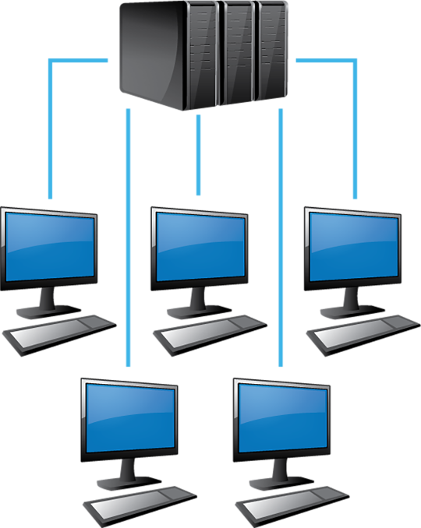
Physical components of a MUOS
An operating system is an abstract concept and therefore does not have any physical components, however, there are physical components that are required for a multi user operating system to function
Processors
  individual users and their applications are allocated CPU time by the process management system
Memory
  memory is allocated to a process by the memory management system
Data storage devices
  storage is handled by the file management system
Terminals
  Allow users to log-in to the MUOS server.
  Initially dumb terminals were only capable of performing simple I/O
  Intelligent terminals now contain microprocessors and can additionally perform their own processing
Output devices
Input devices
Linux
Server

Slide 21
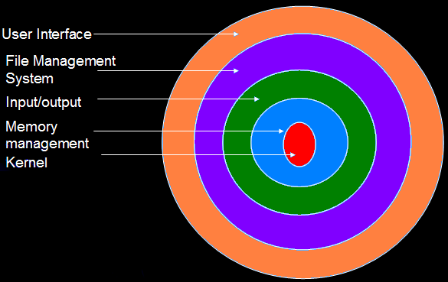
Software Components of a MUOS
The operating system is generally the most complex item of software on a computer, as well as the most important. However, it can be broken down into a number of discrete layers, or functional elements, each of which is responsible for a specific task. A five layer model is often used:
User Interface - software layer which allows the user to interact directly with the operating system
File Management - layer of system software responsible for organising and managing the storage of data on permanent media
I/O System - controls all physical communication with external devices, such as disk drives, keyboard, printers and displays
Memory Management - responsible for sharing the physical memory of the computer between processes
Kernel - responsible for multi-tasking, process control, exception handling (or error handling) and interrupt processing.
Although viewed as separate layers, the kernel often has the responsibility/control of other layers e.g. file system management, memory management

Slide 22
Software Components - Kernel
A program that constitutes the central core of a computer operating system (nucleus) and has complete control over everything that occurs in the system.
The kernel remains resident in memory at all times and interfaces with the hardware (or a HAL Hardware Abstraction Language)
The Kernel is the first part of the OS that is loaded during boot sequence
The kernel is responsible for the following:
  Process scheduling
  Inter process communication
  Interrupt handling
  Memory management
  File system management

Slide 23
Kernel – Process Scheduling
Scheduling is required in order to successfully achieve multi-tasking
  The process scheduler (also called the dispatcher) is responsible for sharing resources and time between the different processes competing for attention
What do we need to consider when scheduling?
  In reality different processes have different needs and some are more urgent or important than others.
  some processes may eligible to run but be unable to do anything because they are waiting on another process completing or on a device becoming available. It would inefficient to let them waste their time-slices doing nothing.
How do we differentiate the needs of each process?
  the user or the system assign a priority to each process.
  The overall amount of time allocated to a process, or how often it is given a time-slice, is determined by the priority – the higher the priority, the faster the process will execute.

Slide 24
Kernel – Process Scheduling
The Kernel groups processes into one of three states:
Running
the process is currently executing on the processor
Ready
the process is ready to be run on the processor
  Blocked
  the process is waiting for a specific event to occur (e.g.: another process to finish, or a device to become available). A process may be in the blocked state if it needs to access a resource that is not currently available. It will not be given any time on the processor until the event it is waiting for occurs.

Slide 25
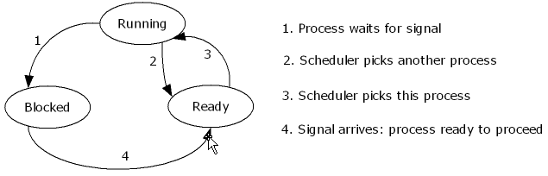
Kernel – Process Scheduling
Other variations of these states are:
Ready Suspend: This is when a process is swapped out of a memory by Memory Management system in order to free memory for other process.
Blocked Suspend: This is when a process is swapped out of memory after incurring an I/O wait
Terminate: This is when a process has finished its run.

Slide 26
Kernel
With multiple processes running concurrently in the operating system they must be able to communicate with each other to synchronise their actions and manage shared data. Inter process communication (IPC) is the mechanism that facilitates this…

Slide 27
Kernel – Inter-Process Communication
Inter-process communication (IPC) is also under the control of the kernel.
It is the job of the kernel to ensure that processes can communicate with each other as required and that protocols for IPC are adhered to.
(Protocol - An agreed-upon format for transmitting data between two devices)

Slide 28
Kernel
In addition to scheduling processes to achieve successful multi-tasking the kernel also has to handle any interrupts…

Slide 29
Kernel – Interrupt Handling
What is an interrupt?
  An interrupt occurs when a currently running process is temporarily suspended (or interrupted) to allow other processes (system processes or fatal hardware interrupts etc.) to access the processor.
What happens when there is an interrupt?
  When an interrupt occurs, it is handled by an interrupt service routine (ISR), sometimes known as an error handler or exception handler. The kernel includes ISRs for many system interrupts such the system clock, power failure and process scheduling. Other ISRs are provided by the device drivers that manage peripheral hardware devices such as network adapters, keyboards and disk drives. The ISRs are a set of steps to undertake in order to handle the specific interrupt
Where do interrupts come from ?
  Interrupts can be generated by hardware or software

Slide 30
Kernel
The number of running processes and subsequently the memory required for storage is simply unavailable, therefore it is the job of the memory manager to solve the problem of limited memory by moving data in and out of the main (primary) memory
The OS solves the problem of limited memory by using a method known as paging:
  Splitting the programs into chunks
  Taking only the chunks of the program that are essential to its operation into memory

Slide 31
Kernel – Memory Management
memory is allocated and de-allocated via the kernel
responsible for sharing the physical main memory of the computer between processes and handling programs which require more memory than physically available
This layer is also responsible for ensuring that the memory allocated to any program is protected against access by other programs.

Slide 32
Kernel – Memory Management
physical memory is divided into a number of logical pages and a program is allocated a number of pages
If all the available pages are already in use the memory management system looks for a page that it can reclaim
  least recently loaded
  least recently used
Identified page is written out to a special system file on the hard disk, the swap file and the space freed is allocated to the program which requested an additional page
process is known as swapping, and gives programs access to a virtually unlimited amount of virtual memory

Slide 33
Kernel
As well as memory required to execute processes, the OS needs a place to store both the programs and the data.
File System Management provides a structure and mechanism to allow the OS to access programs and data easily…

Slide 34
Kernel – File System Management
File system management also falls under the control of the kernel
Layer of system software responsible for organising and managing the storage of data on permanent media.
Files cannot be created, modified or deleted without intervention from a kernel process.
  Controls access to shared files

Slide 35
Software Components – I/O
Device Drivers
  Each device attached to a system needs some way to interface, or talk to or carry out Input/Output (I/O) with the operating system; this is provided via a device handler/driver
  Device drivers are essentially files that store information on how a particular device may be accessed. This way all the intricate details of each device need not be hard coded into an operating system, it simply requires that the appropriate interfaces (device drivers) are available to provide communication with a device
  Every device, physical (and virtual) has a unique set of characteristics and requires its own device driver

Slide 36
I/O – Device Drivers
It is not uncommon for more than one device to wish to talk to the system at one time. These requests for I/O are placed in the device request queue. The queue is serviced in an orderly manner to ensure that I/O operations are carried out efficiently, and without error. The normal mode of operation is as follows:
  While the queue is not empty…
remove the I/O request block (IORB) from the queue
(essentially the details of the I/O operation and its associated driver)
initiate the I/O operation
  (start the I/O request going)
notify the requesting process when the transfer is complete
(let the process know that the I/O has completed - the process may now exit or continue with CPU work accordingly)

Slide 37
I/O - Spoolers
The MUOS allows several processes to share the resources of the computer system to enable multi-tasking but unfortunately not all devices are shareable
  non-shareable devices e.g. printer - A process is allocated to a device and runs until it has completed, at which time the device is released for use by another process. You cannot send more than one request for I/O to a non-shareable device at a time e.g. you can only print one document at a time
  a significant degradation in performance would occur if the processor had to directly control the process for non-sharable devices in addition to its current workload
  Solution - re-direction of requests to use non-shareable devices to a sharable resource (such as an area on hard disk) in order that the processor can continue to work efficiently and not be held up by slower devices that are overrun by the output from other faster processes

Slide 38
I/O - Spoolers
Spooling allows programs to "hand off" work to be done by the peripheral and then proceed to other tasks
A dedicated program, the SPOOLer (Simulataneous Peripheral Operations On-Line), maintains an orderly sequence of jobs for the peripheral and feeds it data at its own rate.
The spool itself refers to the sequence of jobs, or the storage area where they are held.
The spooling process operates at the highest performance
  In many cases the spooler is able to drive devices at their full rated speed with minimal impact on other processing.
  Interrupt driven I/O - when it requires the services of the processor, it gets them on a demand basis by interrupting that which is currently being processed

Slide 39
Software Components – User Interface
link between the user and the facilities available at both a hardware and software level
Command Line Interface (CLI)
  textual interfaces providing users with the ability to communicate with the computer using a command language
  Requires expertise and knowledge but it is powerful and flexible, and use considerably less resources than GUI counterparts
Graphical User Interfaces (GUIs)
  WIMP interface
    Windows
    Icons
    Menus
    Pointers

Slide 40
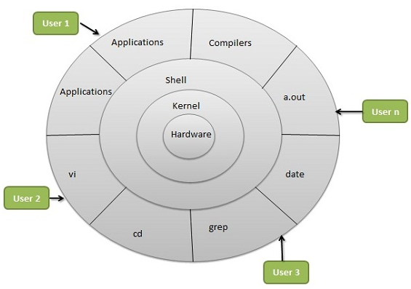
Linux Architecture
Hardware Layer – RAM, CPU, HDD
Kernel - Core component of OS, interacts directly with hardware
Shell - special interpreter program which can be used to execute commands of the OS. An interface to kernel, hiding complexity of kernel's functions from users (technical users / system administrators)
This is how we will interact with the OS.
Utilities - Utility programs giving high-level users most of the functionalities of an operating systems

